Slide 1




FOOD DELIVERY APPLICATION APP
Team : ANITHA M
(agalya2707200@gmail.com)
Guide : BHARATHI RAJA

Slide 2
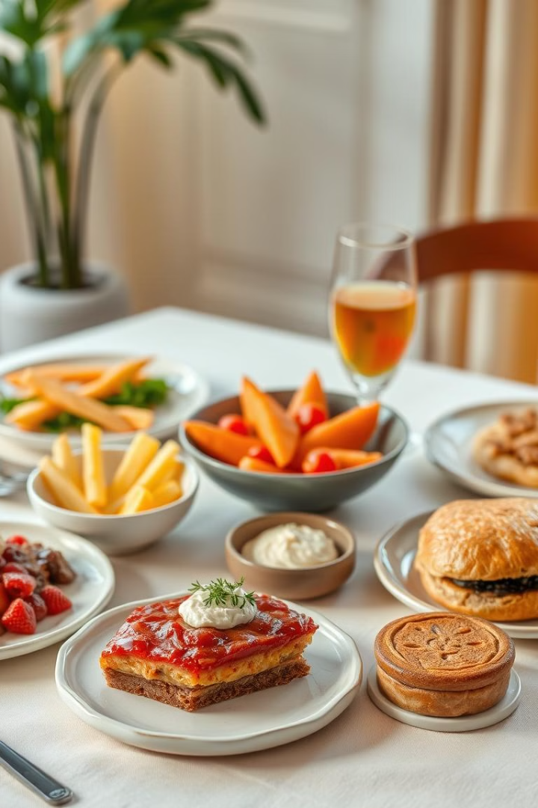
Food Delivery Application App

Slide 3
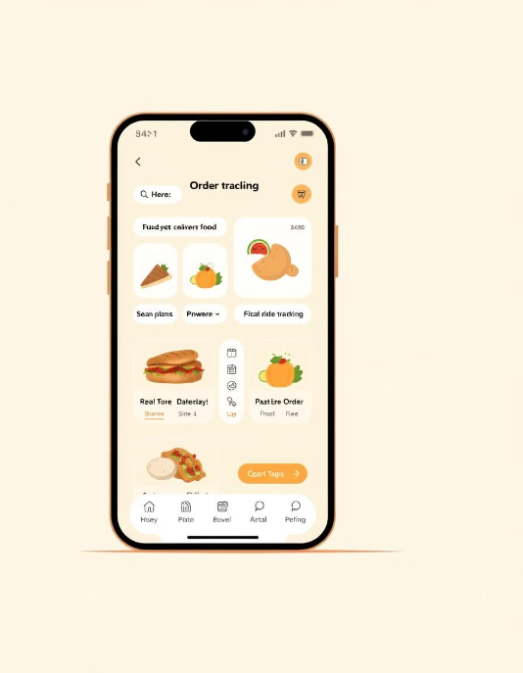
Introduction
Overview of online food delivery trends
The demand for online food ordering is rapidly increasing.
Boosts revenue for restaurants by reaching a larger in audicene.
Develop a MERN-based food delivery app that is secure, scalable, and user-friendly.
Provide authentication, order tracking, and payment integration.
Enable restaurants to manage their menus and orders efficiently.

Slide 4

Technologies
Used
Frontend: React.js, Redux, Tailwind CSS
Backend: Node.js, Express.js
Database: MongoDB (Atlas)
Authentication: JWT, bcrypt.js
Payment Integration: Stripe API / Razorpay
Deployment: Vercel (Frontend), Render/Heroku (Backend)

Slide 5
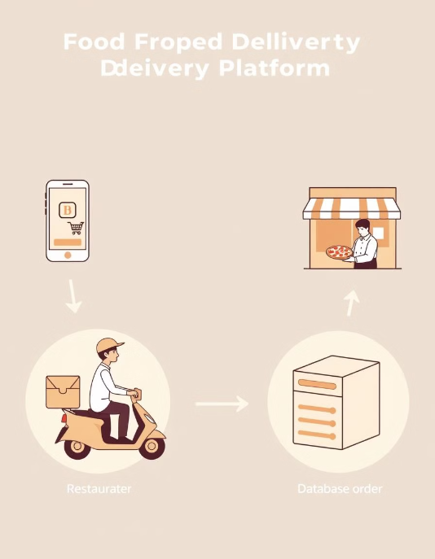
System Architecture
User Module: Browse food items, place orders
Restaurant Module: Manage menu, update orders
Admin Module: Oversee platform, handle disputes
Database Structure: Users, Restaurants, Orders, Payments

Slide 6
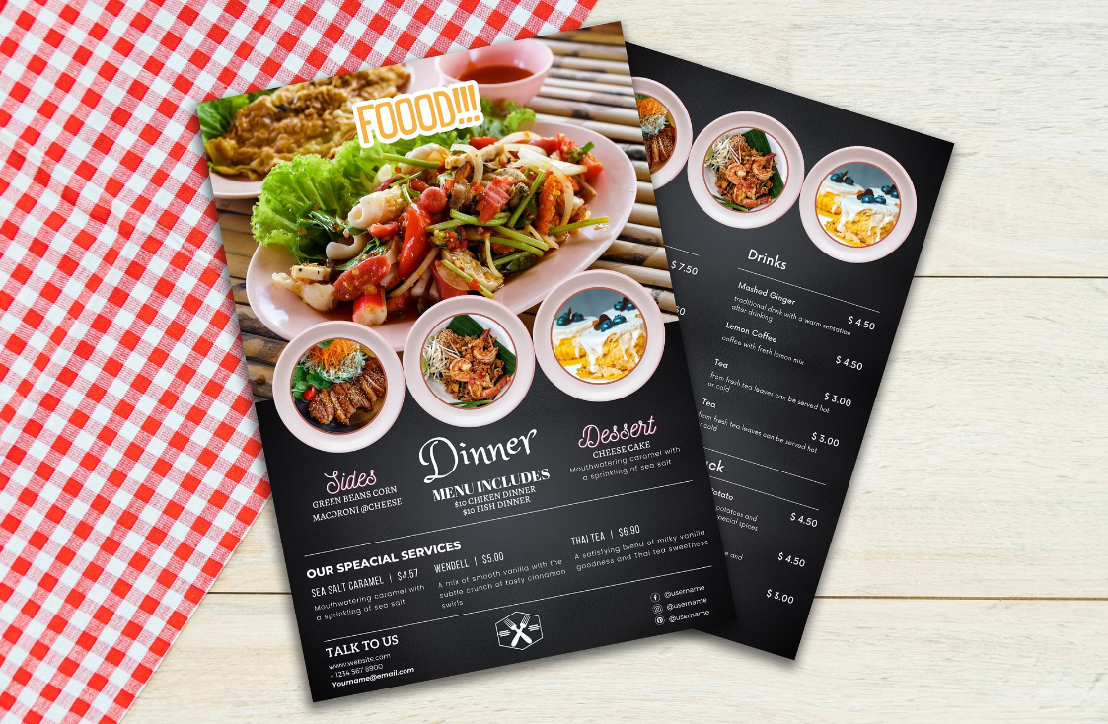
Features & Implementation
User Authentication (JWT)
Food Ordering System (Cart, Checkout)
Payment Gateway Integration
Order Management & Tracking
Admin Dashboard for Monitoring

Slide 7
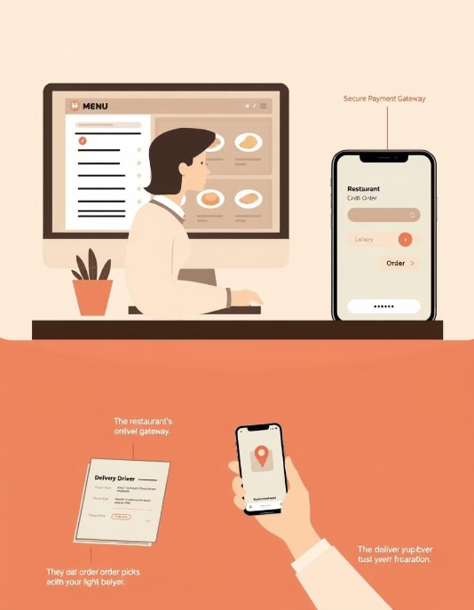
System Workflow
User logs in and selects a restaurant
Adds food items to the cart & places order
Payment is processed (COD/Online
Restaurant receives and updates order status
User tracks the order until delivery

Slide 8
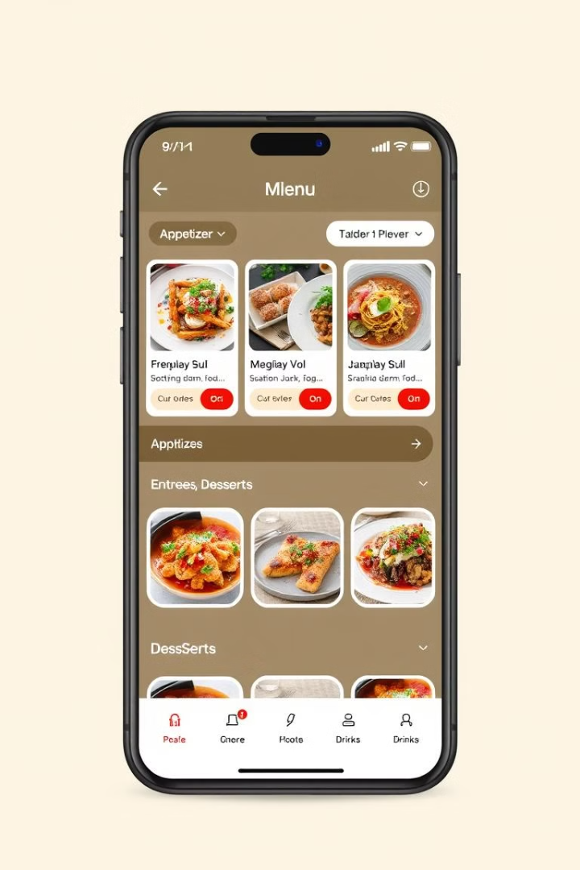




App Features
Browse Menus
Explore detailed restaurant menus with images and descriptions.
Easy Ordering
Customize your orders with add-ons and special requests.
Secure Payment
Pay securely with card or cash options available.
Real-Time Tracking
Track your order from preparation to delivery.
Notes:
The app offers a range of features to enhance the dining experience Users can easily browse detailed menus with images and descriptions of the food options The ordering process is straightforward, allowing customers to customize their orders with add-ons and special requests Secure payment options are available, including card and cash, providing a convenient and trusted checkout experience Customers can track their order in real-time, from preparation to delivery, ensuring transparency and timely fulfillment

Slide 9
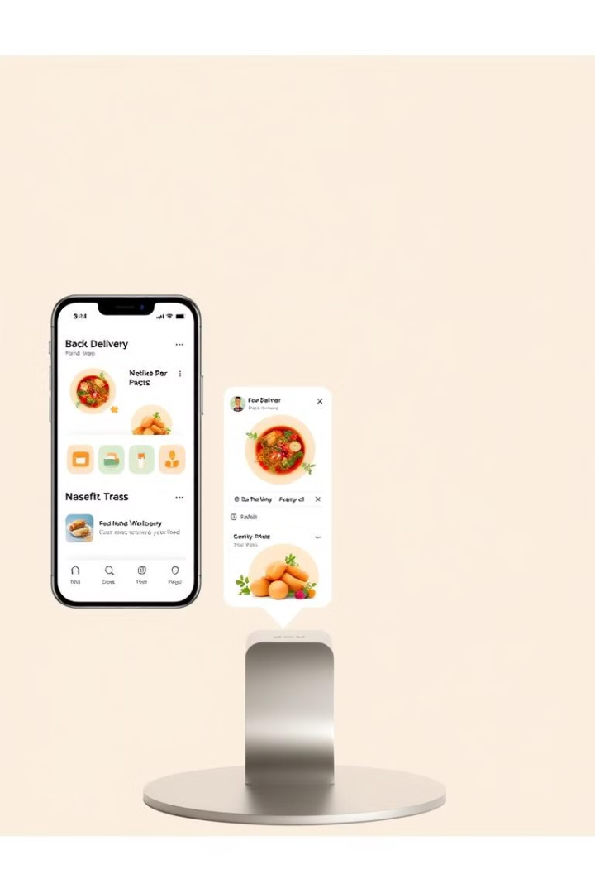




Intuitive User Interface
Effortless Navigation
Quick Checkout
Personalized Profiles
Mobile-Responsive
Enjoy a seamless experience across all devices with our mobile-responsive design. Save addresses and view your order history with personalized user profiles. Complete orders quickly with our streamlined checkout process.

Slide 10
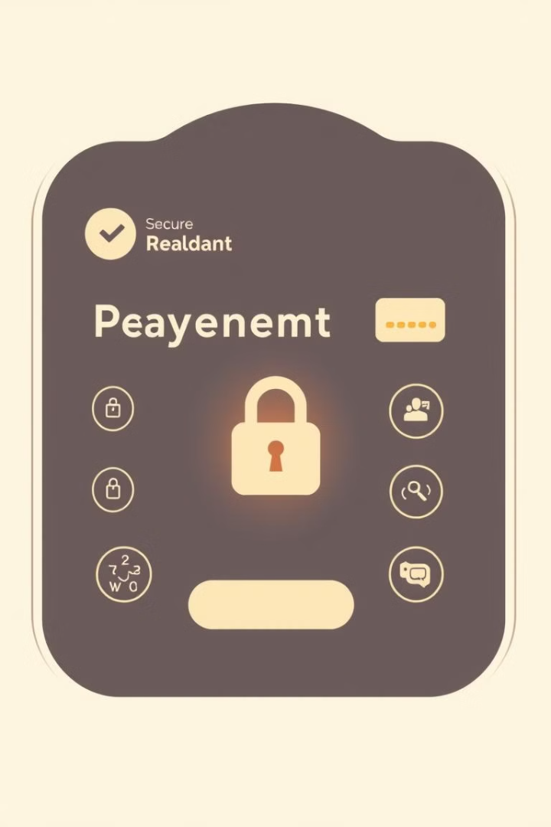



Secure Payment Processing
Payment Gateways
Integrated with secure payment gateways like Stripe and PayPal.
Cash on Delivery
Supports cash on delivery with order verification.
User Authentication
Ensures user authentication and authorization for data product
Notes:
• We've covered a lot today about our MERN Stack Food Delivery App. I hope you can see how it's a robust, secure, and user-friendly solution. • This app represents our vision for the future of food delivery - one that is scalable, performant, and provides an exceptional experience for customers. • While we've made great progress, there are always opportunities for improvement. We'll continue to innovate and enhance the app's features and functionality to stay ahead of the curve. • Thank you all for your time and attention today. I'm happy to take any final questions you may have.

Slide 11
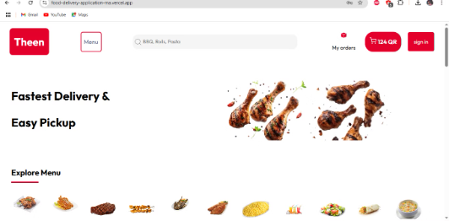
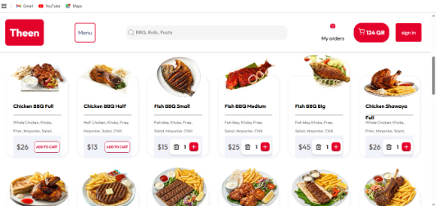
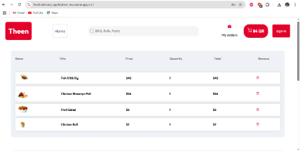
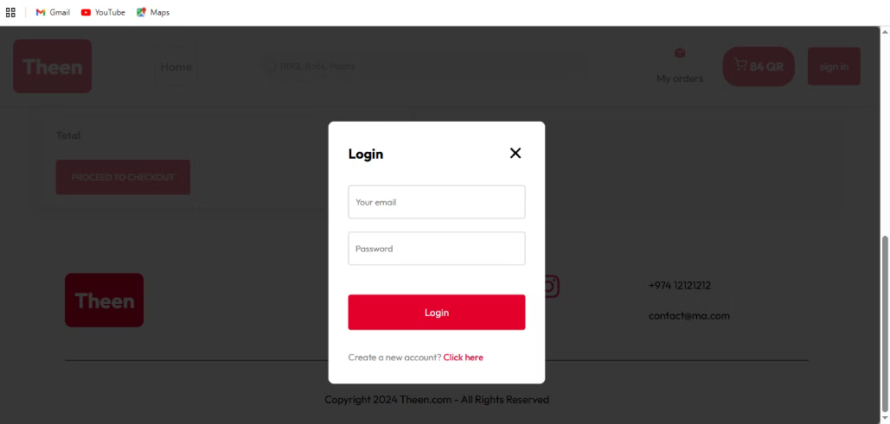
Demo and Screenshots

Slide 12
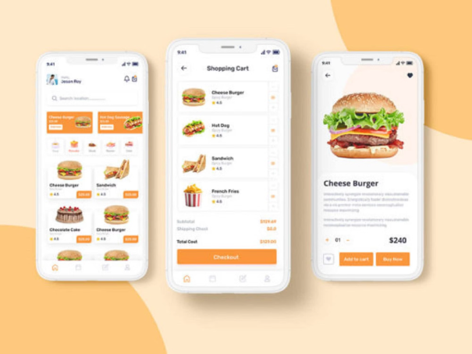
Conclusion
A robust MERN Stack Food Delivery App
Secure, scalable, and user-friendly
Future improvements for better performance
THANK YOU!!!

